Slide 1
Unit 8
Write & Interpret Inequalities
Algebra 1

Slide 2
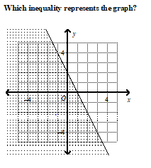

Slide 3
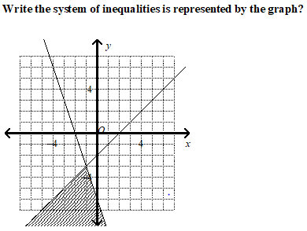

Slide 4
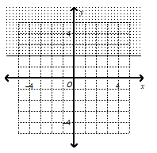

Slide 5
